Slide 1
MPI
SET10108 Concurrent and Parallel Systems

Slide 2
Breakdown
MPI
Communication
Performance Considerations

Slide 3
MPI

Slide 4
What is MPI?
MPI stands for Message Passing Interface
MPI is a library approach to distributed parallelism
It is message based – you should be familiar with the concept
MPI is a standard as well – this means that you should be able to understand MPI on any platform you come across
We use C++
Java has an implementation
So does .NET

Slide 5
Goal of MPI
MPI aims to provide a simple interface for performing collective parallelism
Collective here means a collection of compute nodes working together to solve a problem
MPI achieves this by providing a set of communication functions to work between processes
It also provides a collection of standards to allow simple setup of jobs and the communication infrastructure
We really only touch on this

Slide 6
MPI Functionality
MPI operates using a communicator mechanism
Each process interacting with a communicator is assigned a rank
Direct communication with a process can be achieved using the relevant rank

Slide 7
MPI Functionality
Initially, each process belongs to the WORLD communicator
Sub-groups of processes can create specific communicators
Although communicators can be used to communicate with local threads, MPI is usually considered an inter-process communication mechanism
It is designed to cross the machine boundary

Slide 8
MPI Operations
Some similar to CPA Networking
Send
Receive
Some implementable in CPA Networking
Broadcast
Scatter
Gather

Slide 9
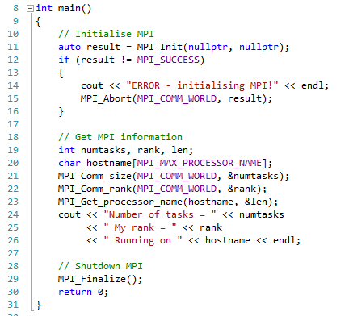
Simple MPI Application

Slide 10
mpiexec and smpd
We can’t run MPI applications as normal applications
No communication infrastructure will be set up
To run an MPI application we use the mpiexec command
mpiexec –np 4 “myapp.exe”
To have a node act as a remote host we use the smpd command
smpd –d
We can then add this as a host in our mpiexec command
mpiexec –np4 –host <ip> “myapp.exe”
Multiple hosts can be used – we can also use config files

Slide 11
Communication in MPI

Slide 12
Send and Receive
Simple MPI messaging can be achieved using the MPI Send and MPI Receive commands
MPI_Send(data, size, type, destination, tag, communicator)
MPI_Receive(data, size, type, source, tag, communicator, status)
These allow simple message passing between processes
MPI also provides a send-receive command
MPI_SendRecv
We will use this when implementing a parallel sort

Slide 13
Message Matching
One thing you must be wary of is message matching
A send-receive combination must match for the communication to complete
Destination and source must be the same
Tag must be the same
Same communicators must be used
Some of these can be set to ignore – in other words I don’t need to care about the tag if I don’t want to
Sends and receives must also happen at the same time (although asynchronous sends exist)

Slide 14
Deadlock
MPI therefore brings in the notion of deadlock
If a communication doesn’t match, it doesn’t complete
If a process is left waiting for a communication, it cannot proceed to the next part of its computation
We therefore need to ensure caution when dealing with standard MPI sending and receiving
Never have two processes try and send to each other at once
Try and avoid a send waiting on a receive

Slide 15
Collective Communication
One of the more powerful features of MPI is its ability to perform group communication
That is send data between more than two processes in a single command
There are a few functions that allow us to do this
Reduce
Broadcast
Scatter-Gather
We will look at these individually – we will also use them in the practical

Slide 16
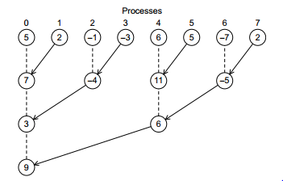
Map-reduce
MPI provides a reduce command
MPI_Reduce
This means we can have all our applications running a single program and the results gathered to a single process
MPI_Reduce(local, global, size, type, operation, root, communicator)
All reduce also exists to send the result to all processes

Slide 17
Collective vs. Point-to-point Communication
There are some points to remember when dealing with collective communication
All processes in the communicator must participate in the collective communication
Arguments must match
Only the destination process actually needs a place to store the result – however all processes must provide a parameter (null is allowed)
Collective communication doesn’t use tags

Slide 18
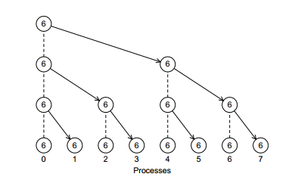
Broadcast
Another useful collective communication is the broadcast
MPI_Bcast
The broadcast command allows a message to be sent from one process to all others in the communicator
MPI_Bcast(data, size, type, source, communicator)
Very useful for distributing messages at the start of a job

Slide 19
Scatter
Another useful group communication is the scatter command
MPI_Scatter
Scatter will take an array of values and distribute them evenly across all the processes in a communicator
MPI_Scatter(data, size per process, type, local data, size per process, type, source, communicator)
This is useful when distributing a collection of data that can be computed independently
Single-Program, Multiple-Data

Slide 20
Gather
After a scatter we typically want to gather the results together again
MPI_Gather
Gathering can be considered the reverse of scattering – all processes send data back to the source which stores them in an array
MPI_Gather(local data, size per process, type, data, size per process, type, destination, communicator)
MPI also provides an All Gather method to enable results to be sent to all the processes involved

Slide 21
Datatypes
MPI supports a number of data types natively
MPI_INT
MPI_FLOAT
MPI_CHAR
MPI_UNSIGNED
The Introduction to Parallel Programming book provides more details for those of you who are interested
These have set sizes so be cautious – they might be the size you expect or they might not. This can lead to weird behaviour

Slide 22
User Defined Data Types
You can also define your own data types to send in MPI
To do this you have to think about the packing of your data
We did this to a certain extent in graphics programming and uniform blocks
When you derive a type, you have to use the MPI_Type_create_struct command to initialise it with MPI
This requires the struct size, the size of the parts, the types of the parts, etc.
Can be useful if you want to send complex data
The Introduction to Parallel Programming book explains more for those that are interested

Slide 23
Performance Considerations

Slide 24
Latency
Remember that latency is our overhead on basic communication
It is a measure of messaging – not the amount of data sent
Latency in MPI is simple enough to measure
Ping-pong application
Single byte messages
1 sends, 2 receives
Swap – 2 sends, 1 receives
Do a number of iterations to get a reasonable result
Divide time for ping-pong by two to get an approximation of latency

Slide 25
Bandwidth
Bandwidth is actually trickier in MPI
Basic ping-pong with various message sizes
Powers of 2
Start power 8
End power 24
MPI is smart however
Broadcast messages optimised
Group communication optimised
You will have to measure both if using both

Slide 26
Group Communicators
Depending on the communication medium MPI sits upon it can perform faster communication
Broadcast is the most obvious here
On TCP/IP communication the broadcast can utilise the protocol to enable distribution of the data by the network infrastructure
Be warned however – this does depend on the communication and the communication medium
Serial comms don’t have the ability to broadcast in this manner for example

Slide 27
Syncing
When taking timings across a network it is sometimes useful to sync the processes to ensure timings are correct
MPI provides a mechanism to do this using a barrier
MPI Barrier
MPI Barrier works exactly like the barrier used in JCSP
All processes on the barrier must sync
Barrier is communicator based – create sub-communicators if necessary
MPI_Barrier(comm)

Slide 28
Efficiency
Remember that we have to take into account communication time now
Last week we discussed message time using latency and bandwidth
This provides us with an overhead – part of the application is effectively serial as we distribute data for example
These must be taken into account when measuring and working out your efficiency and speedup calculations

Slide 29
Summary
After today you should know
What MPI is and its goals
How point-to-point communication works in MPI
What group communication mechanisms we have in MPI
What are some of the performance considerations in MPI
Chapter 3 of the Introduction to Parallel Programming book is a must read at this stage

